Slide 1
Experimental Design and Ecological Sampling
Pablo E. Gutiérrez-Fonseca, PhD
University of Vermont
Spring 2025

Slide 2
What is Experimental Design?
An experimental design is the laying out of a detailed experimental plan in advance of doing the experiment.
Why it is important?
Well chosen experimental design maximize the amount of information that can be obtained for a given amount of experimental effort.
Without proper design, inferential statistics is something not even possible.

Slide 3
Why should you care?
Without proper design it is often impossible to get the information you want from data collected.
Good design saves both time and money.
Employers recognize this and seek individuals with these skills.

Slide 4
Key Information for Experimental Design
Define the problem: Hypothesis or study objective.
State variables of interest (independent, dependent, controls, covariates).
Construct a Sampling Design:
Identify the population of interest (what are we trying to represent)
Determine the Sampling unit (what is an observation)
Appropriate sampling unit size and shape?
How many observations?
Selected and positioned how? (consider controls or pairings?)
4. Develop your Methods (how, where and when to sample, quality control measures).
5. This information will help you identify the correct statistical analysis (we’ll cover this throughout the semester).

Slide 5
Define the problem: Hypothesis or study objective
Hypothesis: statement of the expected outcome of an experiment.
Characteristics of a goo Hypothesis:
Clear, concise statement of expected results.
Based on scientific theory or observation
Is testable
Identifies the key variables included
Specifies the nature of the relationship or differences expected
Define the population of interest.

Slide 6
Define the problem: Hypothesis or study objective
Clear and Concise: Clearly states the expected outcome.
Example: Higher soil moisture will increase tree growth rates in Vermont forests.
Based on Theory or Observation: Grounded in prior knowledge or observations.
Example: Based on the understanding that moisture availability influences tree growth.
Testable: Can be evaluated with data collection.
Example: Measure tree growth in areas with varying soil moisture levels.
Identifies Key Variables: Specifies independent and dependent variables.
Example: Soil moisture (independent) and tree growth rate (dependent).
Specifies Relationship: Defines the expected interaction between variables.
Example: Increased soil moisture is expected to enhance tree growth.
Defines Population: Specifies the study context or target population.
Example: Mature deciduous trees in Vermont forests.

Slide 7
Define the problem: Hypothesis or study objective
A study objective outlines the purpose of research when there is no specific hypothesis to test statistically. Instead, it focuses on describing, monitoring, or understanding a system. Here are the key characteristics:
Clear and Concise Statement of the Goal or Knowledge to Be Gained:
The objective should clearly articulate what the study aims to achieve or learn.
Example: "To assess the effects of varying soil moisture on tree growth in Vermont forests."
Identified Key Variables:
Clearly identify the main variables that will be measured or observed in the study.
Example: Soil moisture levels and tree growth rates.
Defines the Population of Interest:
Specify the specific population or system that the study will focus on.

Slide 8
Define the problem: Hypothesis or study objective
Hypothesis:
H1: Food availability influences the growth rates of a fish species in a given aquatic ecosystem.
This hypothesis makes a specific prediction about the relationship between food availability and the growth rates of the fish species, and it can be tested statistically.
Study Objective:
To examine and describe the feeding habits and ecological interactions of a specific fish species, aiming to understand how these factors may influence the growth patterns of the fish.
In this study objective, the emphasis is on describing and investigating the feeding habits and growth patterns of the fish species without specifying a detailed hypothesis for statistical testing. The objective guides the general aim of the research without making a specific predictive statement about the influence of food availability on growth rates.

Slide 9
Variables of interest
Independent variable (manipulated variable):
This is the variable that is deliberately changed or manipulated in the study. It is the primary focus of the experiment to see how it affects the dependent variable.
Example: In a study on tree growth, the independent variable could be soil moisture levels.
Dependent variable (responding variable):
This variable changes in response to the manipulation of the independent variable. It is what you measure to assess the effect of the independent variable.
Example: The growth rate of trees, which responds to changes in soil moisture.

Slide 10
Variables of interest
Control:
Controls are factors that are kept constant throughout the experiment to ensure that the results are due to the manipulation of the independent variable, not other factors. Controls help establish a standard of comparison.
Example: Using the same tree species, consistent light exposure, and the same soil type across all test groups.
Covariate:
Covariates are factors that could influence the dependent variable but cannot be fully controlled. Including them helps to account for their potential impact in statistical analysis, ensuring more accurate results.
Example: In a tree growth study, covariates might include temperature, nutrient availability, or pest pressure—factors that can influence growth but are difficult to control completely.

Slide 11

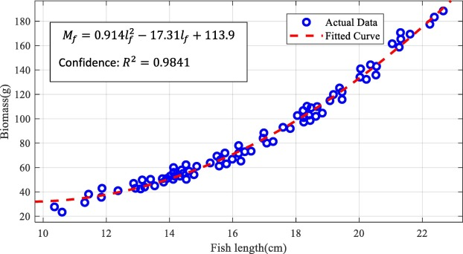
Sample, replicate and pseudo replicate
Sample
A statistical sample is a subset of items which is used to represent the population from which they are drawn.
It has two connotations (1, Sokal & Rohlf 2009):
Individual observations, which are taken in small units.
These smaller sampling units are often, but not necessarily, individuals in the biological sense.
If we take the weight of 100 fish, then the weight of each fish is an individual observation.
Notes:
https://onlinelibrary.wiley.com/doi/10.1111/ele.13134

Slide 12
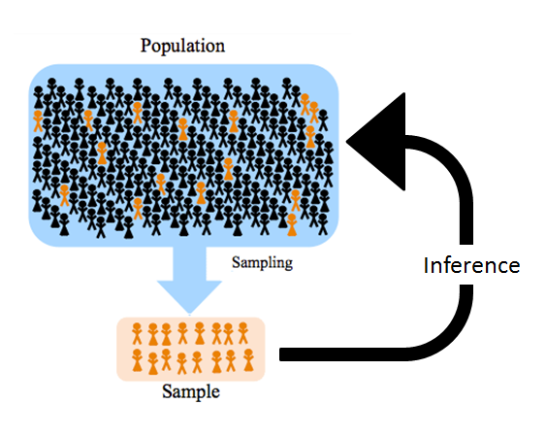
Sample, replicate and pseudoreplicate
Sample
A statistical sample is a subset of items which is used to represent the population from which they are drawn.
It has two connotations (2, Sokal & Rohlf 2009):
A set of individuals that are examined to estimate the average value.
Each set of individuals are considered as basic sampling units.
If we wish to measure temperature in a study of ant colonies, where each colony is a basic sampling unit, each temperature reading for one colony is an individual observation,
and the sample of observations is the temperature for all the colonies considered.

Slide 13
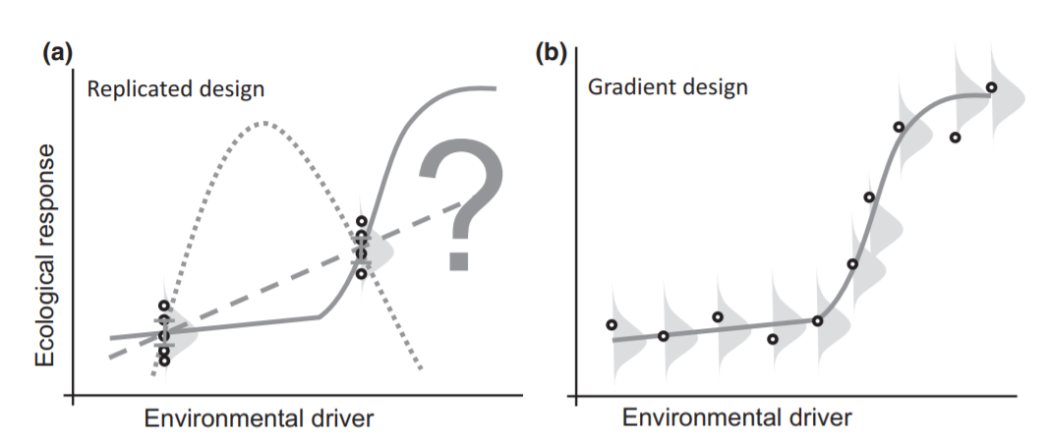
Sample, replicate and pseudoreplicate
Replication
Replication means having observations replicated at a spatial and temporal scale that coincides with the application of the experimental treatments.
In statistics, replicates mean different samples that capture random variations of the system.
Replicas are essential because biological systems are inherently variable, and this is particularly true for ecological systems.

Slide 14

Sample, replicate and pseudoreplicate
A sample is a subset of a population, while a replicate involves the repetition of experimental conditions to ensure the reliability of results.
Samples are used in statistical inference, while replicates contribute to the robustness and reliability of experimental outcomes.

Slide 15
Sample, replicate and pseudoreplicate
Studying the Effect of Temperature on Fish Growth in Mesocosms
Sample: In this study, your sample refers to the individual mesocosms in which you are conducting the experiment. Each mesocosm represents a controlled environment where you manipulate temperature levels. You have three different treatments:
Control (Mesocosm 1)
Treatment 1 (+5°C) (Mesocosm 2)
Treatment 2 (+10°C) (Mesocosm 3)
Each mesocosm is like a sample because it is a distinct unit subjected to different temperature conditions.
Replicate: Within each temperature treatment group (Control, Treatment 1, Treatment 2), you have six replicates. Replicates involve creating identical or very similar instances of each treatment to account for variability. For example:
Control Replicates (Mesocosms 1-6)
Treatment 1 Replicates (+5°C) (Mesocosms 7-12)
Treatment 2 Replicates (+10°C) (Mesocosms 13-18)
These replicates allow you to observe how the growth rate of fish responds to temperature variations within each treatment group. Having six replicates per treatment enhances the reliability of your findings and helps account for potential variability.

Slide 16


Sample, replicate and pseudoreplicate
Sample: In this context, each mesocosm can be considered a sample because it represents an individual observation or data point. Therefore, the number of samples is equal to the total number of mesocosms you have in your experiment.
Replicate: Multiple instances of each temperature treatment (six replicates per treatment) to ensure robustness and account for potential variations in fish growth responses to temperature.
Replicate

Slide 17
Sample, replicate and pseudoreplicate
Pseudoreplication
Hurlbert (1984) to refer to "the use of inferential statistics to test for treatment effects with data from experiments where either treatments are not replicated (though samples may be) or replicates are not statistically independent.
Heffner et al (1996) distinguish a pseudoreplicate from a true replicate, which they characterize as ”the smallest experimental unit to which a treatment is independently applied.”

Slide 18
Methods
Describe how measurements will be made for each variable of interest.
Timing and frequency of collection
When: State the timing of collection (e.g., seasonal).
How Often: Define frequency (e.g., daily, weekly).
Field or lab methods
Field: Explain field procedures and equipment.
Lab: Outline lab analysis methods.
Quality control
Calibration: Regularly calibrate instruments.
Replicates: Use multiple samples for accuracy.
Blanks: Check for contamination with blanks.

Slide 19
Sampling design
Sampling design proposed method of selecting a subset of the population for measurements.
Observation (or Sampling Unit):
Individual Plants or Animals: Measure specific organisms.
Plant or Animal Parts: Sample parts (e.g., leaves, scales).
Quadrants: Define and sample areas (e.g., 1m²).
Lines (Transects): Sample along a line across the study area.
Points: Collect samples at specific points.

Slide 20

Understanding Statistical Power
Sampling Design and Statistical Power
Proper sampling design ensures that data collected are relevant and sufficient for analysis.
A well-designed sample increases statistical power, making it more likely to detect true effects or differences.
Notes:
power is defined as the probability that a statistical test will reject the null hypothesis or the ability of a statistical test to detect an effect. Power is equal to 1-b (beta). In order to reject the null hypothesis (which states that there is no relationship between the variables of interest), power should be at least .80.
o conduct a power analysis, you must also have a sense of the significance level you want to use in your statistical analysis. A common choice in research is alpha=.05. You should also have a sense of how much power is required to detect an effect when conducting a power analysis. This is expressed as power=1 - ß, where ß is the probability of a Type II error. Power=0.80 is common, but one could also choose Power=.95 or.90.
Choose effect sizes based on what is typically observed in your field or use Cohen’s estimates of small, medium and large effect sizes. Finally, its good to have a sense of the sample size you are capable of handling (in terms of time and resources) when conducting a power analysis. A larger sample size is likely to increase your ability to detect a significant difference or effect, but you may not have the resources required for collecting a large sample. Based on the power analysis, you can determine whether the study is worth pursuing. Many students think that there is a simple formula for a power analysis, but power analysis varies by research situation.

Slide 21
Understanding Statistical Power
Statistical Power is the probability that a statistical test will correctly reject a null hypothesis (no relationship between variables) when it is false, indicating a true effect exists.
Power Value:
A power of 0.9 means a 90% chance of detecting a significant difference if it truly exists, and a 10% chance of missing it (Type II error).
A power greater than 0.8 is considered adequate, indicating an 80% chance of detecting a significant result if a true effect exists.
Statistical power is intricately linked to the number of observations.
Notes:
power is defined as the probability that a statistical test will reject the null hypothesis or the ability of a statistical test to detect an effect. Power is equal to 1-b (beta). In order to reject the null hypothesis (which states that there is no relationship between the variables of interest), power should be at least .80.
o conduct a power analysis, you must also have a sense of the significance level you want to use in your statistical analysis. A common choice in research is alpha=.05. You should also have a sense of how much power is required to detect an effect when conducting a power analysis. This is expressed as power=1 - ß, where ß is the probability of a Type II error. Power=0.80 is common, but one could also choose Power=.95 or.90.
Choose effect sizes based on what is typically observed in your field or use Cohen’s estimates of small, medium and large effect sizes. Finally, its good to have a sense of the sample size you are capable of handling (in terms of time and resources) when conducting a power analysis. A larger sample size is likely to increase your ability to detect a significant difference or effect, but you may not have the resources required for collecting a large sample. Based on the power analysis, you can determine whether the study is worth pursuing. Many students think that there is a simple formula for a power analysis, but power analysis varies by research situation.

Slide 22
Understanding Statistical Power
What affects your required sample size?
The probability threshold (α) for rejecting the null hypothesis.
Typically set at 0.05, meaning a 5% chance of incorrectly rejecting a true null hypothesis.
The probability of correctly rejecting the null hypothesis when it is false.
A power of 0.8 means an 80% chance of detecting a true effect if it exists.
Level of Significance
Power
Should be > 0.8
Fixed
Should be < 0.05
Effect Size
Fixed
Refers to the strength or size of the difference or relationship you are trying to detect in your study.
Smaller effects need larger samples to find.
Variability
Required Sample Size
The degree of variation in the data.
Higher variability requires larger sample sizes to detect an effect.
Notes:
You're correct! In the context of statistical analysis, only Effect Size and Variability are considered fixed elements, as they are inherent properties of the data or the phenomenon being studied.
Here’s a breakdown:
Effect Size: Fixed because it represents the magnitude of the difference or relationship you’re studying, and once defined, it remains constant for that particular analysis.
Variability: Fixed because it reflects the inherent spread or dispersion in the data, and once measured, it is set for that dataset.
Level of Significance and Power are not fixed in the same way:
Level of Significance is a threshold you set before conducting the test, so it’s chosen but not fixed by the data itself.
Power depends on multiple factors, including sample size and effect size, so it’s calculated based on those choices, not inherently fixed.

Slide 23
Sampling design
Sampling techniques
Non-Probability sampling.
In non-probability sampling, the researcher chooses the sample based on subjective judgment rather than random selection.
Probability sampling.
Probability sampling is a technique in which the members of the sample are chosen randomly from the population. Every member has an equal opportunity to be a part of a sample of this type.

Slide 24
Sampling design
Sampling techniques
Non-Probability sampling.
Judgmental
Probability sampling.
Simple random
Stratified random
Systematic and Grid Sampling
Adaptive Cluster Sampling
Ranked Set Sampling

Slide 25
Sampling design: Judgmental Sampling
Definition: Selection of sampling units (number, location, timing) based on the researcher's judgment rather than random or systematic methods.
Limitations: Conclusions are limited by the accuracy and validity of the researcher's judgment. Probabilistic statements about parameters are not possible.
Appropriate Use:
Descriptive Studies: To explore or describe phenomena where random sampling is impractical.
Pilot Studies: To test methods or gather initial insights.
Emergency Response: For immediate data collection when quick decisions are needed.

Slide 26
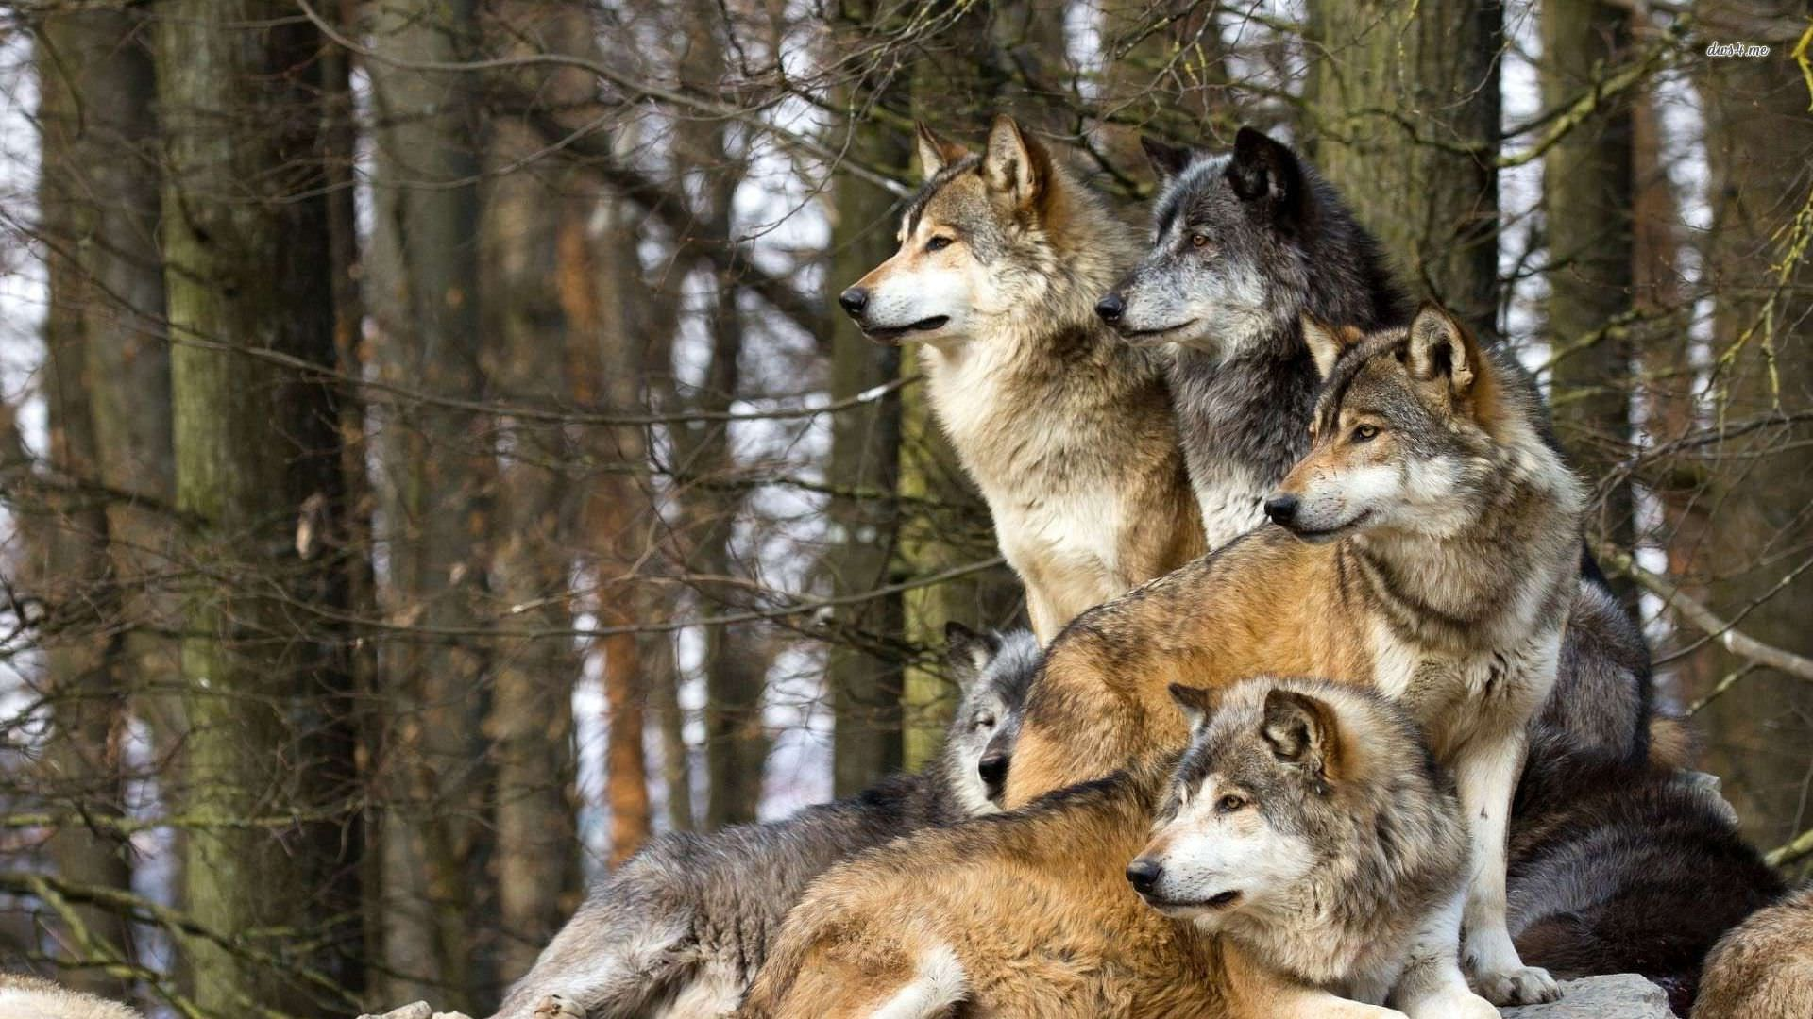
Sampling design: Judgmental Sampling
You are monitoring the wolf population in Yellowstone and need to quickly estimate breeding success to determine if further monitoring is necessary. You have time to assess 3 of your packs.
Random Sampling: Of the 10 packs in the park, you randomly select 3 to visit.
Judgmental Sampling (Vulnerable Packs): You visit the dens of the most vulnerable packs within the park’s borders to assess litter size.
Judgmental Sampling (Least Impacted Packs): You visit the dens of the packs that you know are least impacted by your intrusion to assess litter size.

Slide 27
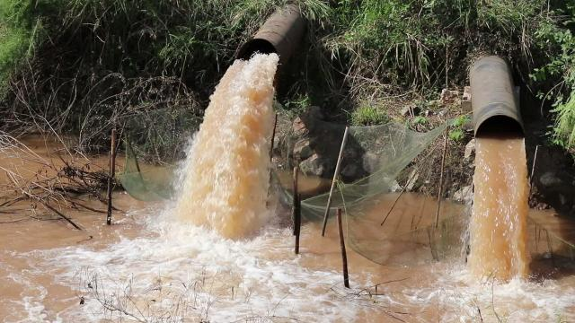
Sampling design: Judgmental Sampling
You are monitoring water quality in Lake Champlain but have time to collect only 10 samples at regular intervals.
Random Sampling: Use GPS to randomly select 10 points around the Lake Champlain waterfront.
Judgmental Sampling: Collect samples from 10 key locations where pollution loads are highest (e.g., near sewage plants, stormwater drains, or areas with agricultural runoff).

Slide 28
Sampling design
Sampling techniques
Non-Probability sampling.
Judgmental
Probability sampling.
Simple random
Stratified random
Systematic and Grid Sampling
Adaptive Cluster Sampling
Ranked Set Sampling

Slide 29
Sampling design: Random sampling (Probability-based sampling design)
Definition: Applies sampling theory with random selection, giving each member of the population an equal chance of being selected.
Benefits:
Provides statistically unbiased estimates of the mean and variability of the larger population.
Enables probabilistic statements about parameters, supporting conclusions with confidence levels.
Allows for statistical inference.
Applications: Ideal for comparative, experimental, and modeling studies.

Slide 30
Sampling design: Random sampling (Probability-based sampling design)
Key Assumption of Probability-Based Design:
The sample must be representative of the entire population.
To Achieve This:
Use random, unbiased sampling methods.
Collect enough samples to ensure accurate representation.
Distribute sampling units well across the population.
Ensure sampling units are independent (no spatial correlation).

Slide 31
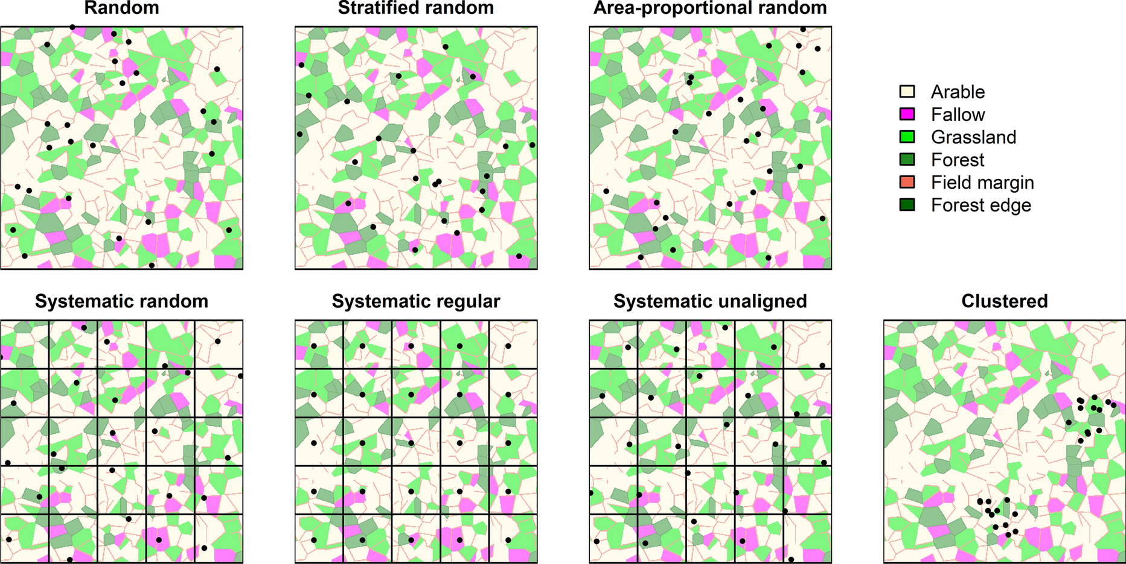
Sampling design: Random sampling (Probability-based sampling design)
Simple Random Sampling: Sampling units are selected randomly, with each having an equal chance of being chosen.
Best Use: Ideal when the population is relatively homogeneous, with no major patterns or hotspots expected.

Slide 32
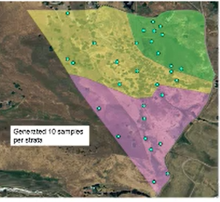
Sampling design: Random sampling (Probability-based sampling design)
Stratified Random Sampling: The target population is divided into non-overlapping strata or subpopulations that are more homogeneous.
Best Use: Effective when the population is heterogeneous and can be subdivided by specific characteristics. It enhances precision in estimating means and variances and provides reliable estimates for subgroups of special interest.

Slide 33
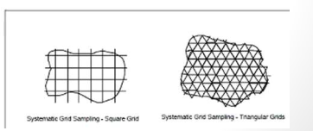
Sampling design: Random sampling (Probability-based sampling design)
Systematic and Grid Sampling: An initial location or time is chosen at random, followed by sampling at regular intervals across space or time.
Best Use: Useful for identifying hotspots, estimating spatial patterns, and detecting trends over time. Ensures uniform coverage of the study area.

Slide 34
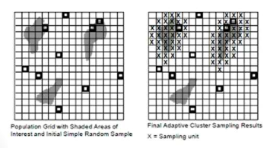
Sampling design: Random sampling (Probability-based sampling design)
Adaptive Cluster Sampling: Starts with simple random sampling, then additional samples are taken where measurements meet specific criteria, with potential for several rounds of sampling and analysis.
Best Use: Ideal for estimating or detecting rare characteristics and is suited for inexpensive, rapid measurements. It helps delineate hotspot boundaries while providing unbiased estimates of the population mean using appropriate weighting of all collected data.

Slide 35
Sampling design: Random sampling (Probability-based sampling design)
Ranked Set Sampling: Uses a two-phase design where inexpensive measurements rank multiple locations within a set, then selects one location from each set for more detailed sampling.
Best Use: Cost-efficient and incorporates professional judgment into a random design. It typically provides more representative samples and more precise estimates of the population mean compared to simple random sampling.

Slide 36
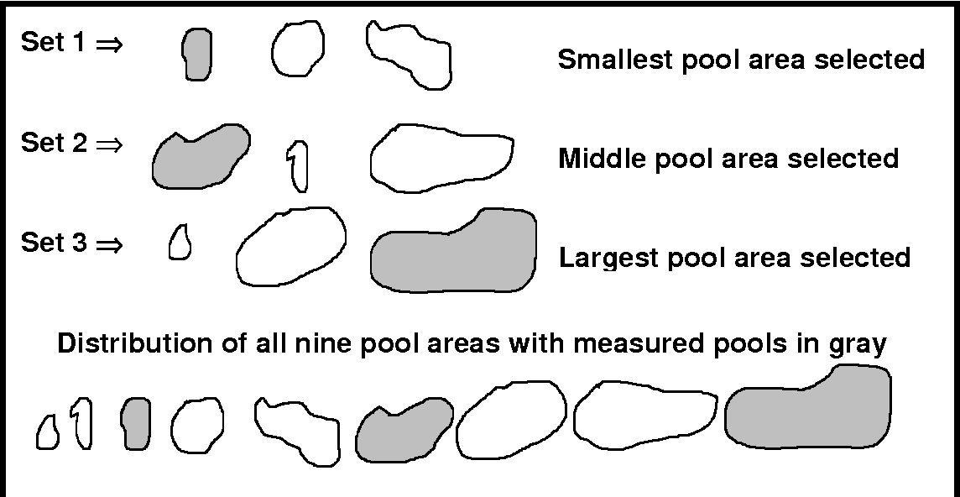
Ranked set sampling vs Adaptive cluster sampling
Figure 1. Ranked set sample to estimate mean pool area. Pools for three sets of size three are randomly chosen from the stream reach. Within each set the pool areas are ranked using visual examination, and the selected pool area is measured accurately. The final set of three observations (shaded in gray) is a representative sample of the underlying distribution of pool areas.
Notes:
https://www.semanticscholar.org/paper/Ranked-set-sampling-for-ecological-research%3A-for-of-Mode-Conquest/d008d622fce327a4df69bd4f87c7faf89f71b9dd

Slide 37
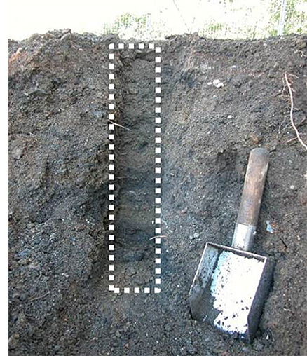
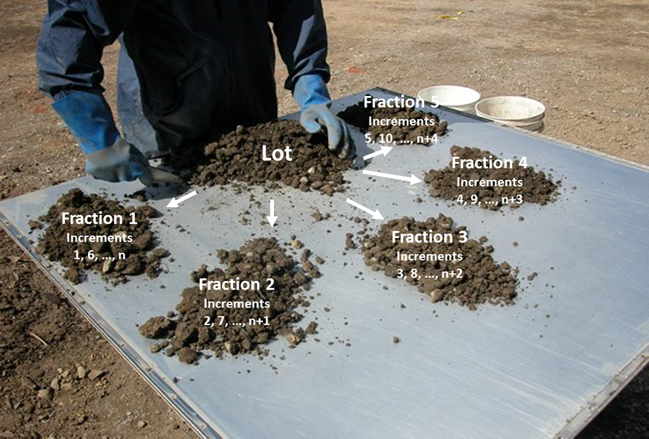
Sampling design: Random sampling (Probability-based sampling design)
Composite Sampling: Combines and mixes materials from multiple sampling units to create a single, homogeneous sample for analysis.
Best Use: Ideal for estimating the population mean when spatial or temporal variability information is not required. Often used with other sampling designs.

Slide 38
When to choose what
Random sampling is great, but it isn’t always appropriate or the best approach to get at the information you need
Judgmental sampling is best when you have a very specific question with a targeted condition or all you want to do is describe a sample
Simple random is best when you have a homogeneous population
Stratified random is best when population heterogeneity can be accounted for based on characteristics of groupings
Systematic (grid) is best when you want to describe spatial patterns or obtain uniform coverage
Adaptive cluster is best to locate rare characteristics and to discern boundaries for those characteristics
Ranked set is best to prioritize sampling for really expensive measurements
Composite sampling is best when we have high spatial variability but are only interested in overall averages (not spatial patterns)
Judgmental Sampling
Simple Random Sampling
Stratified Random Sampling
Systematic Sampling
Adaptive Cluster Sampling
Ranked Set Sampling
Composite Sampling

Slide 39
Sampling design
There is no one correct way to sample.
You must balance the need for an ideal statistical design and the reality of the time, money and access to observation you have.
As long as you can:
Justify your selection of sampling technique.
Ensure that your sample selection is unbiased and representative.
Cover the full range you expect to see in the population.

Slide 40
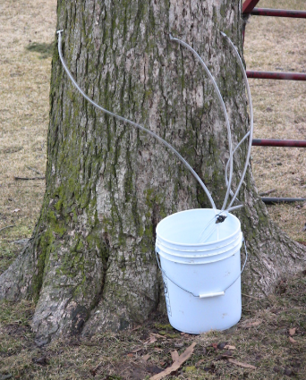
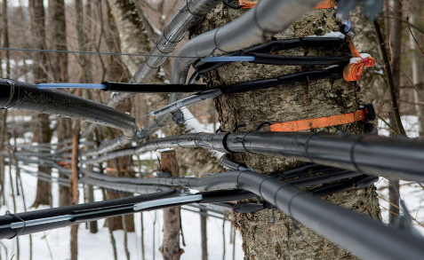

Key information for experimental design
Since 2004 the number of taps in Vermont has gone from a reported 2,100,000 to 4,490,000 and
Production has gone from 500,000 gallons to 1,390,000 gallons
The value of this production has risen from approximately 14 million dollars in 2004 to 44.5 million in 2014 (National Agricultural Statistics Service, 2006 and 2015).

Slide 41
Key information for experimental design
Define the problem: Hypothesis or study objective
Does industrial scale sugaring impact the health of sugar maple stands.
Identify the population of interest (what are we trying to represent)
Sugar maple stands in VT
State Variables of interest (independent, dependent, controls, covariates)
Dependent: Mean Crown Vigor (0-4, healthy to dead), Independent: Sugaring intensity (none, low, high)
Confounding factors: Soil type, elevation, drainage, stand density, disturbance (0/1)

Slide 42
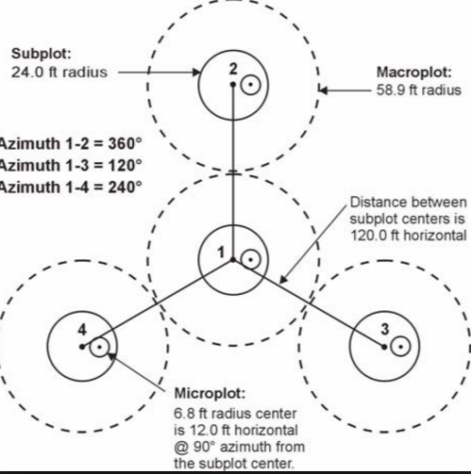
Key information for experimental design
Construct a Sampling Design
Determine the Sampling unit (what is an observation)
Appropriate sampling unit size and shape?
Let's follow best practices and use the FIA (Forest Inventory Analysis) inventory and assessment plot design.
Each plot consists of 4 sub-plots.
Sampling Unit = plot
Sub-plots = replicates

Slide 43
Key Information for Experimental Design
Construct a Sampling Design
Determine the Sampling unit (what is an observation)
Appropriate sampling unit size and shape?
How many observations?
General rule of thumb is as many as possible based on time and resources.
But you can conduct a power analysis to estimate how many you need…….

Slide 44
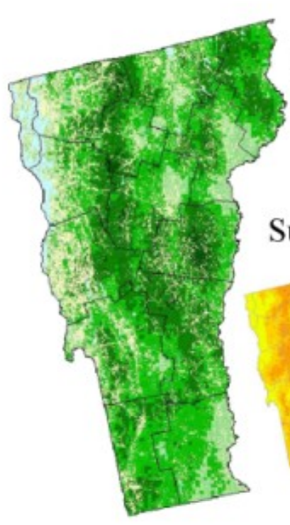





Experimental Design practice:
Sampling Design:
You can assess canopy condition at up to 30 plots across the state
Each of these plots is made up of 4 sub-plots
A plot is a sampling unit
A subplot is a replicate within each plot
But how do I pick where to put these 30 plots?
Sugaring operations:
low volume
Medium volume
High volume

Slide 45
To describe the potential impact of maple sugaring on sugar maple health we assessed canopy condition at:
30 randomly located plots
(organisms are distributed homogeneously)
This is an example of the [x] sampling technique.
Simple Random
Selected stands
Notes:
Minute 26:31
https://www.youtube.com/watch?v=U6tCjlsEqrE

Slide 46
To describe the potential impact of maple sugaring on sugar maple health we assessed canopy condition at:
(organisms are distributed heterogeneously)
10 randomly located plots
at 3 high volume,
3 mid-volume, and
3 low-volume sugaring operations.
This is an example of the [x] sampling technique.
Stratified Random
Selected stands
Notes:
Minute 30:10

Slide 47
To describe the potential impact of maple sugaring on sugar maple health we assessed canopy condition at:
15 stands where I can pair similar tapped and untapped sugar maple stands.
This is an example of the [x] sampling technique.
Judgemental
Selected stands
Notes:
Minute 12: 42
https://www.youtube.com/watch?v=U6tCjlsEqrE

Slide 48
To describe the potential impact of maple sugaring on sugar maple health we assessed canopy condition at:
30 grid point located stands
across the state.
This is an example of the [x] sampling technique.
Systematic Sampling (Grid)
Selected stands
Notes:
Minute 30:30
Ensure Uniform coverage.
You can identify hotspot. Identify geographic pattern

Slide 49
To describe the potential impact of maple sugaring on sugar maple health we assessed canopy condition at:
1. Rough Assessment:
Conduct a broad canopy condition check across all active sugarbushes statewide.
Rank sites by vigor (1 = very good, 3 = very poor, 2 = moderate decline).
2. Selection of 30 Stands:
Choose 30 stands with mean vigor:
3 (poor condition),
< 1 (very good condition),
= 2 (moderate decline).
This is an example of the [x] sampling technique.
Ranked Set
Selected stands
Notes:
Minute 35:17

